Slide 1
Synapse Development

Slide 2
Basics of Synapse Development

Slide 3
Platforms
Dedicated SQL pool
Serverless SQL pool
Spark pool
Data Explorer pool
Synapse Pipelines

Slide 4
SQL pools
Dedicated SQL pool
Query using T-SQL – supports the ‘normal’ syntax plus more
Provides Kimball-style data warehousing
Great for solving “known” business problems
Minimum data expectations: 1 TB of data, 1 billion rows in largest fact table
Serverless SQL pool
Query using T-SQL – supports a subset of the normal syntax
Access data lake data in an ad hoc fashion
Great for “spelunking”

Slide 5
Other Pools
Spark pool
Primary languages: Scala, Python, Java
Secondary languages: SQL, F#, C#, R (in preview)
Great for complex data transformation
Emphasizes procedural logic
Data Explorer pool
Kusto Query Language (KQL)
Great for log and event analysis

Slide 6
Synapse Pipelines
Based on Azure Data Factory code base
Works best for ELT, sometimes for ETL

Slide 7
Where Is My Data?
Dedicated SQL pool
Split into 60 distributions but can logically be considered together
Closest thing to a “normal” database for SQL Server users, though plenty of differences
Data Lake
Data files stored in Azure Data Lake Storage Gen2
Typically follows a particular hierarchical breakdown: Measure \ Year \ Month \ Day \ {Hour \ … }
Data typically stored in quasi-structured formats: CSV/delimited file, JSON, ORC, Parquet

Slide 8
Where Is My Data?
Lake Database
Data stored in a data lake
Metadata holds information on lake files and folders
Allows interoperation between Spark and serverless SQL pools
Spark views only available in Spark pools, not serverless SQL pool
Serverless SQL pool can read Spark external tables in Parquet, CSV, or Delta format—Delta format in public preview
Data Explorer pool
Unique storage engine opaque to end users
Data not stored in data lake and not available to other pools

Slide 9
So You Need to Develop Something
Notebooks
Code
Quick and easy method for writing code
Can include code, documentation (via Markdown), images, and results in same file
Low-friction way to perform analysis and get things done
Design and develop code-based solutions in IDEs
Execute using commands like spark-submit

Slide 10
So You Need to Develop Something
Why Notebooks?
Why Code?
Easy to create and maintain documentation: in line with the code
Supports multiple languages in the same notebook
Great for pedagogical purposes
Good interface in Synapse Studio
Do not need a separate notebook runner to execute
Easier to read code in other tools
Easier to compare in source control
Better for automating activities

Slide 11
So You Need to Develop Something
Why Not Both?
Notebooks can import and use custom-developed functions
Code can be based on notebooks
Synapse Pipelines can run both notebooks and code

Slide 12
Options for Deploying Code

Slide 13
Options
Pass around notebooks (.ipynb format)
Run Synapse pipelines
Deploy pipelines via Azure DevOps or GitHub YAML pipelines
Deploy code from source control using ADO or GitHub

Slide 14
Source Control in Synapse Studio
Use a Git repository to create and save notebooks and other Azure resources
Integrate with your development environment
Resource publication (saving scripts and notebooks) will save to repo
Resource deletion will commit immediately—do not need to publish and cannot undo from Studio
Can NOT customize your commit message on check-in

Slide 15
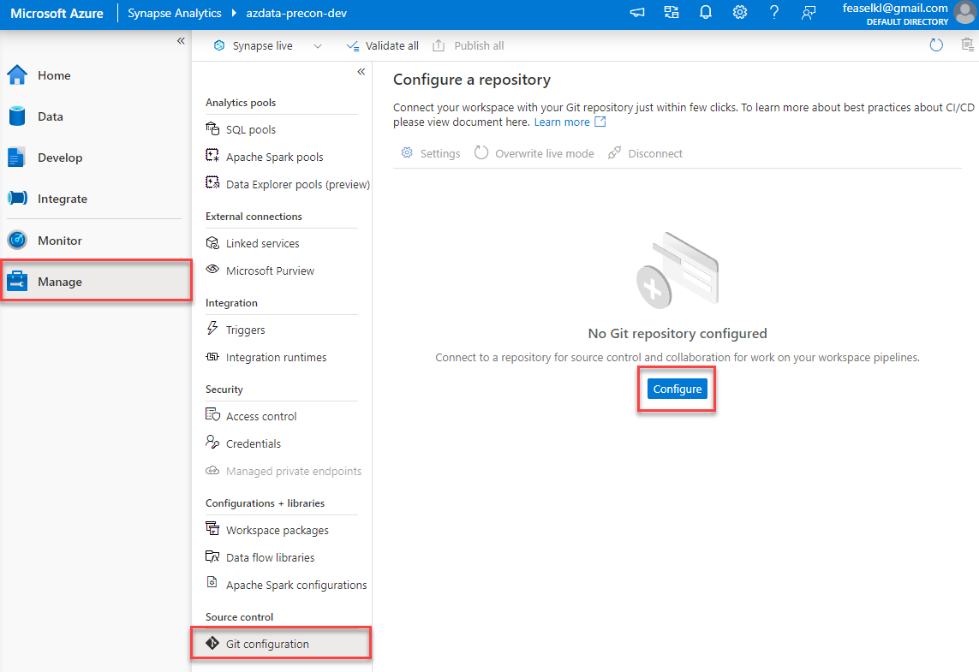
Source Control in Synapse Studio

Slide 16
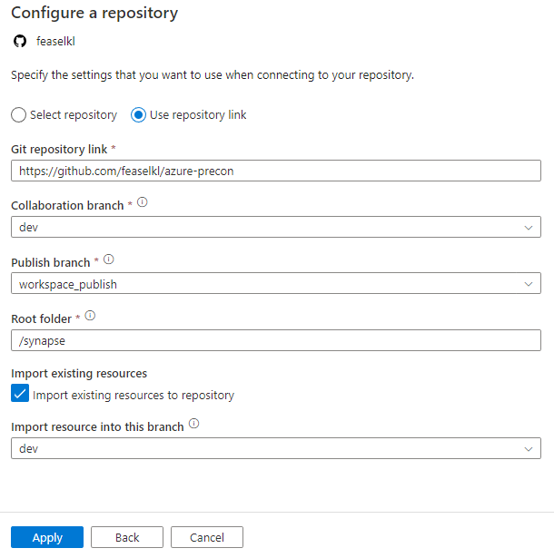
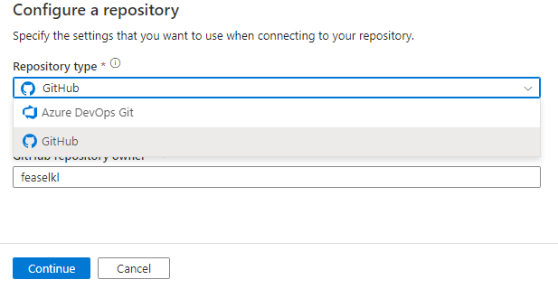
Source Control in Synapse Studio

Slide 17
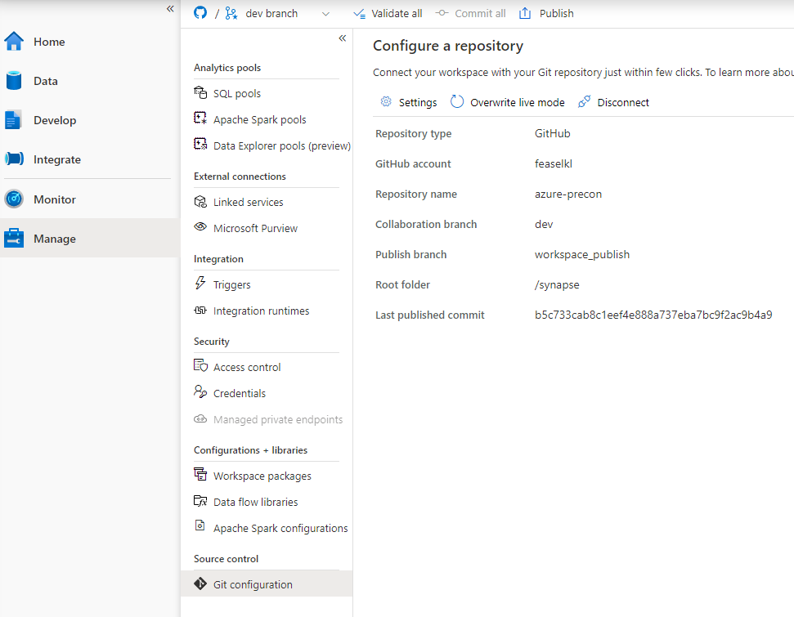
Source Control in Synapse Studio

Slide 18
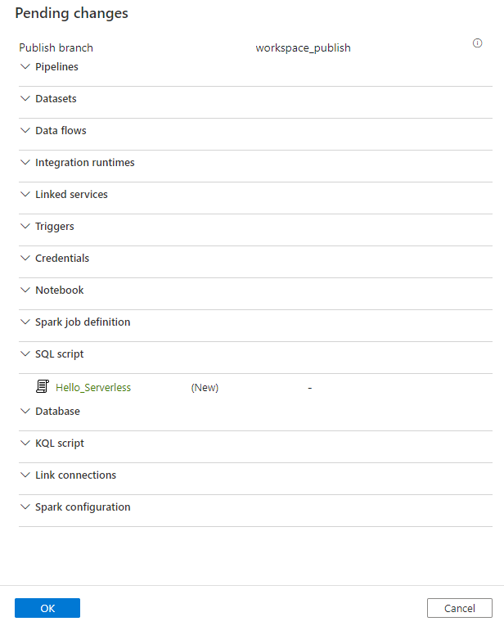
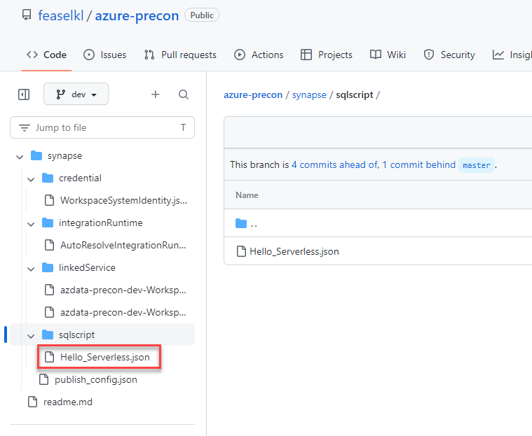
Source Control in Synapse Studio

Slide 19
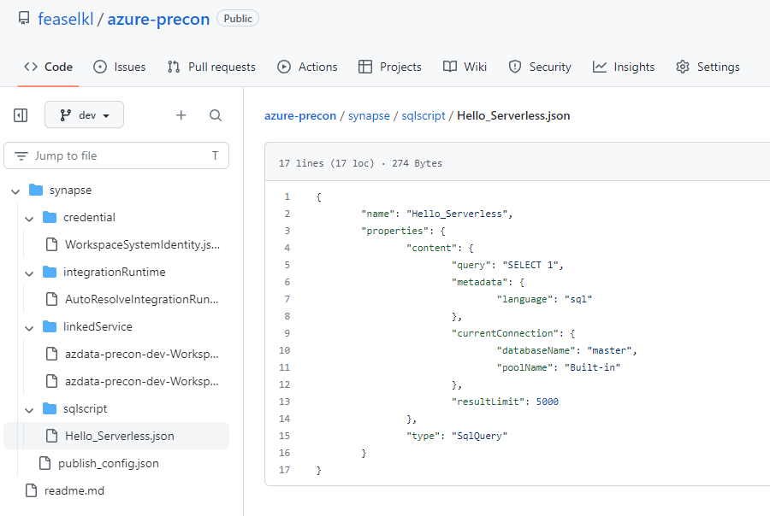
Source Control in Synapse Studio

Slide 20
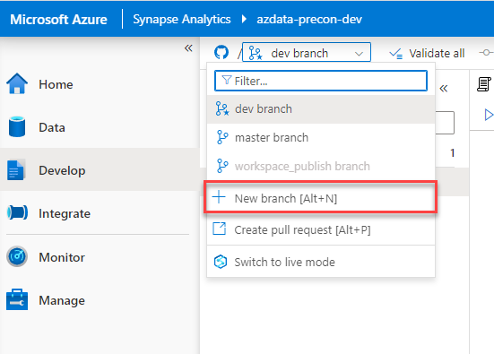
Feature Branching
Can create branches and perform pull requests from within Synapse Studio
Feature branches not required but recommended for multi-developer teams—don’t publish directly to the collaboration branch

Slide 21
CI/CD and Synapse
Git integration is for saving scripts in dev
Still need a process for pushing resources to test/prod environments
Intended to deploy pools and workspaces as well as artifacts hosted in source control
Does NOT perform a “schema comparison” between Synapse workspaces
Options:
Azure DevOps release pipeline
GitHub Action

Slide 22
CI/CD and Synapse – Base Requirements
Any necessary service principals or managed identities must be pre-configured
Source control must be configured for the dev workspace
Test/prod workspace must be created
Don’t configure source control
Ensure that deployment service account has Owner on new workspace
Manually create any self-hosted integration runtimes
Dedicated SQL pools should NOT be paused when performing a deployment

Slide 23
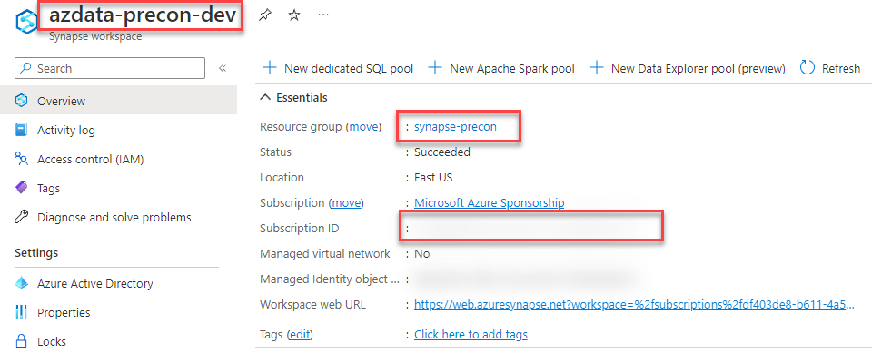
Creating a GitHub Action – Prep Work
Need information for secrets
WORKSPACE
RESOURCE_GROUP
SUB_ID

Slide 24
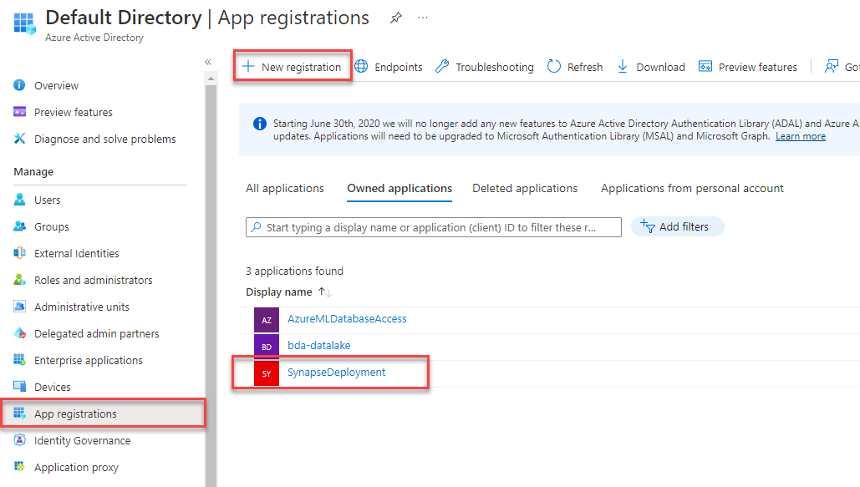
Creating a GitHub Action – Prep Work
Create an App Registration in Azure Active Directory

Slide 25
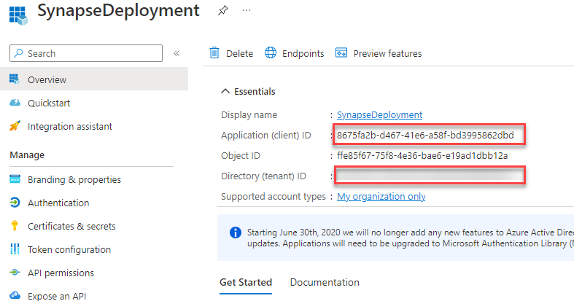
Creating a GitHub Action – Prep Work
Need more information for secrets
CLIENT_ID
TENANT_ID

Slide 26
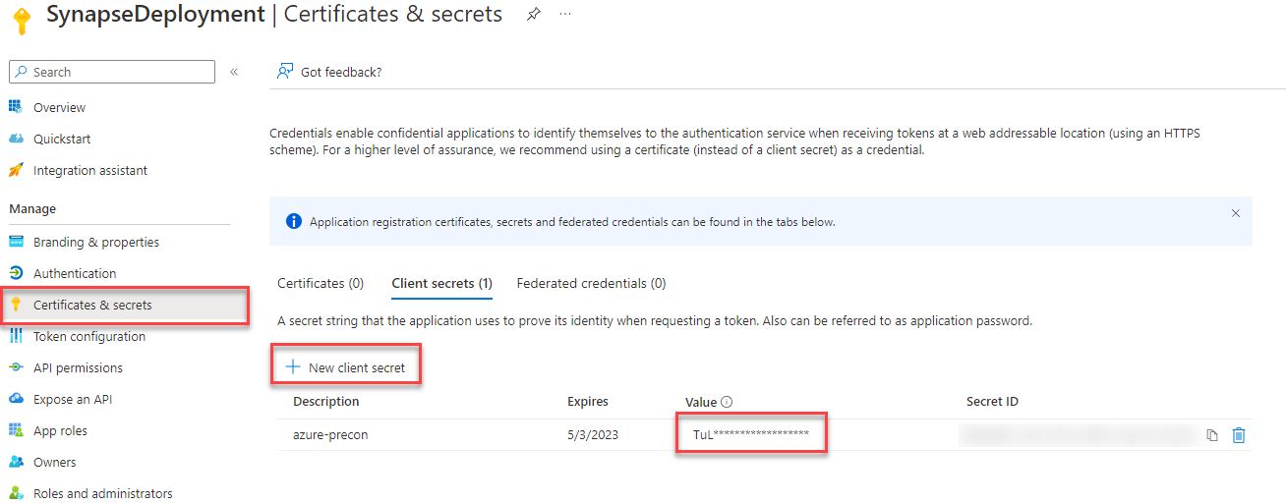
Creating a GitHub Action – Prep Work
Create a new client secret
Make sure to save this—you only see it once!

Slide 27
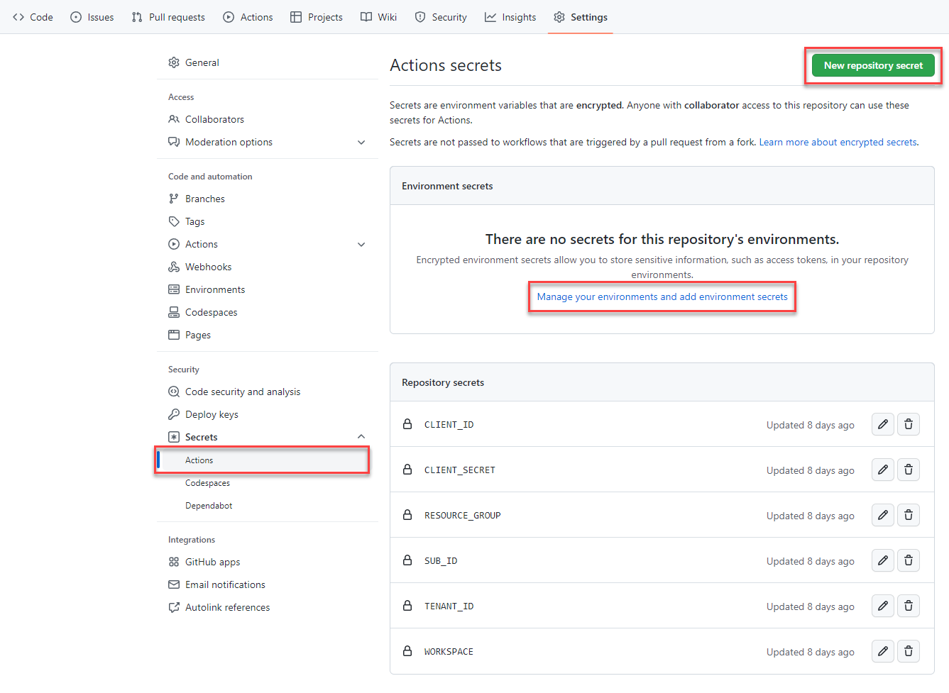
Creating a GitHub Action – Secrets

Slide 28
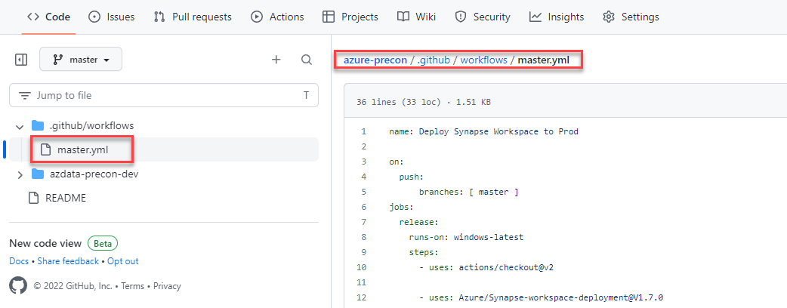
Creating a GitHub Action – YAML
GitHub Actions are YAML files in .github/workflows
Define when and where: on push (or PR), to specific branch(es)

Slide 29
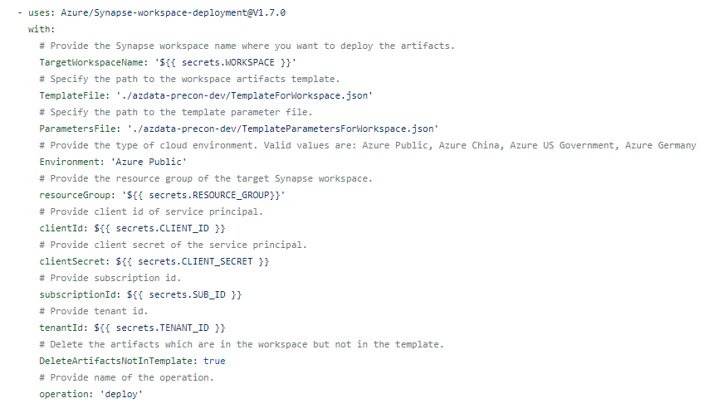
Configuring a GitHub Action
Synapse deployment is a job step and requires the secrets we created

Slide 30
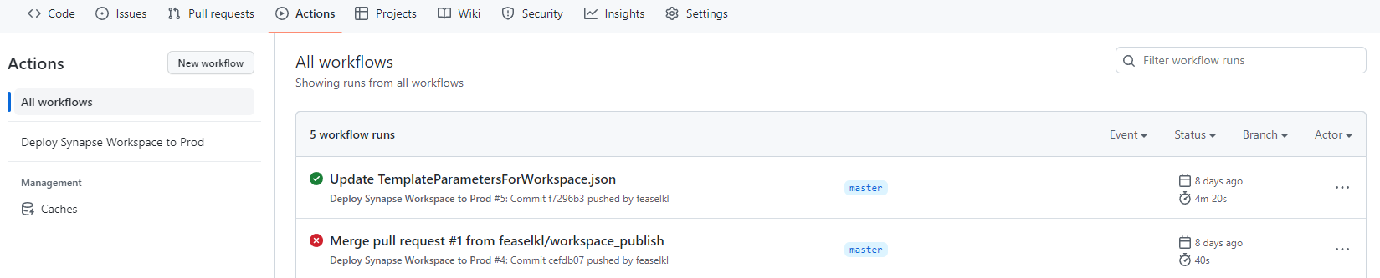
Synapse Workspace Deployment
Track workflows via the Actions menu

Slide 31
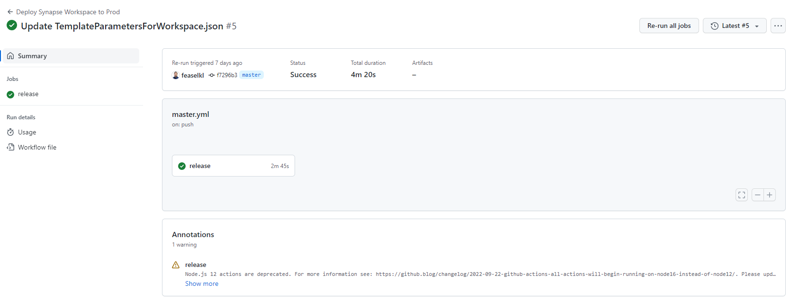
Synapse Workspace Deployment
Each workflow run has its own information, including job steps and results

Slide 32
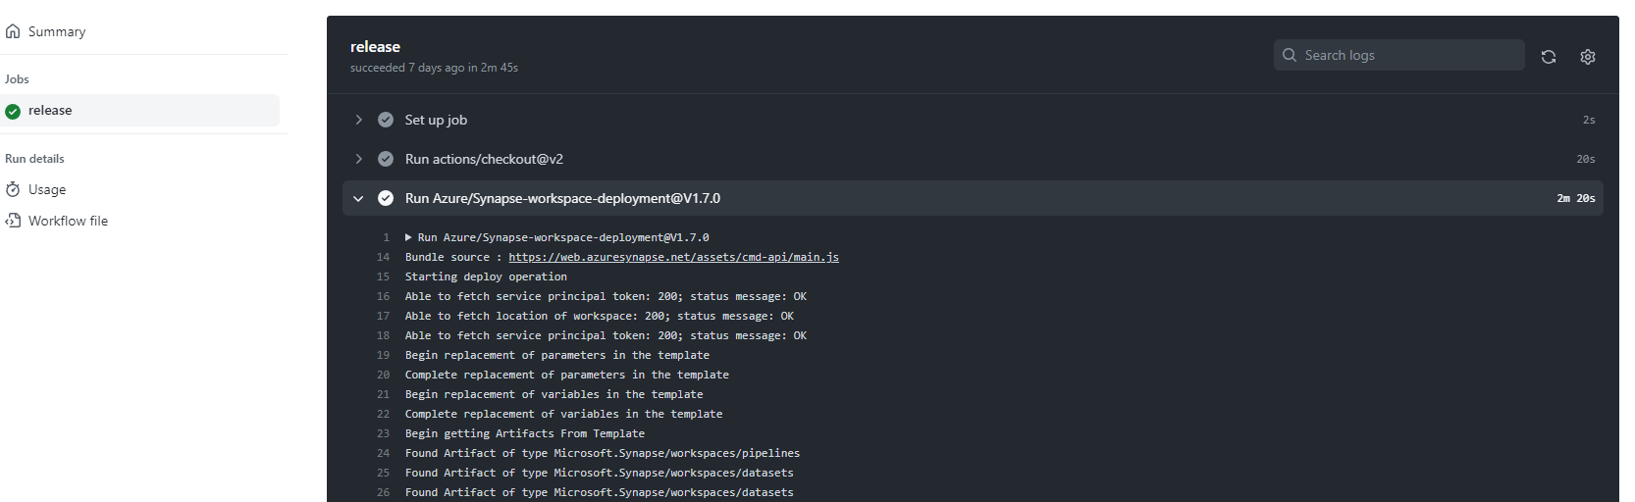
Synapse Workspace Deployment
Each job step includes detailed logs

Slide 33
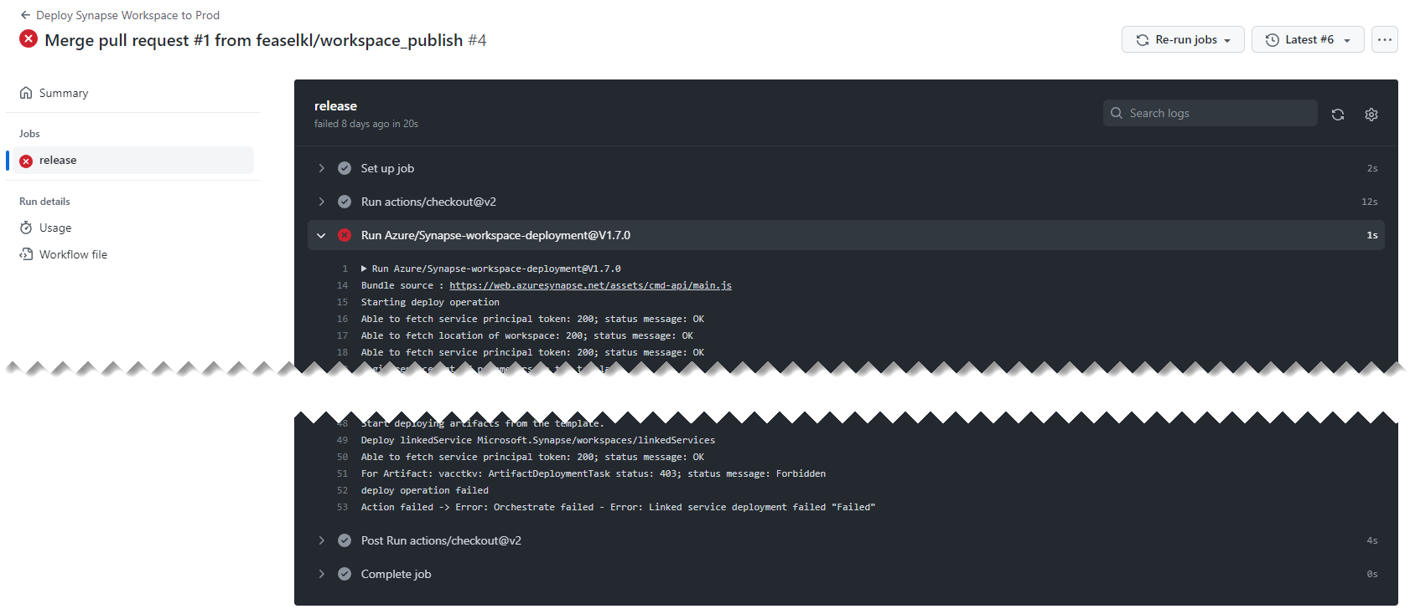
Synapse Workspace Deployment
Failed steps are clearly marked though you may need to search logs

Slide 34
Things to Keep in Mind
Workspace integration with Git is for your development environment
Deploy changes to test/production workspaces via CI/CD
Using a Managed VNet? Be sure to have a self-hosted ADO/GitHub agent do the deployment!

Slide 35
Development in Python

Slide 36
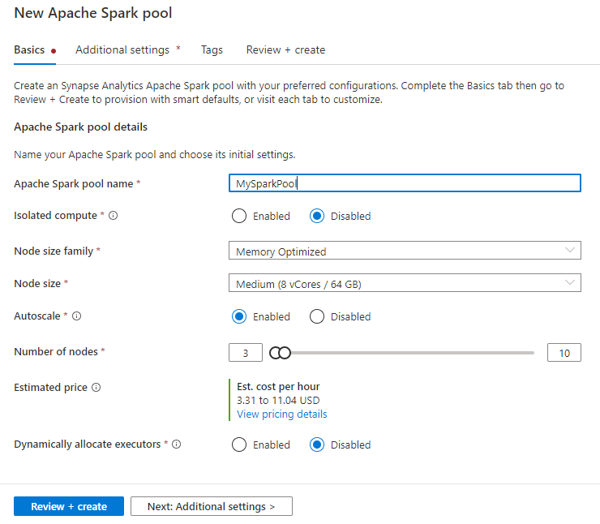
Start with a Spark pool
Node sizes
Node families
Node scaling
Isolated compute
Pausing and shutdown

Slide 37
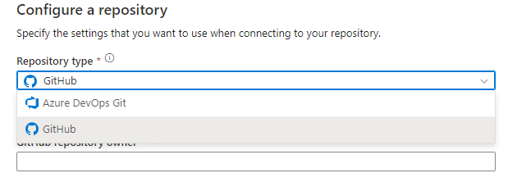
Connect to Source Control
Code must be in Git: GitHub or Azure DevOps
Store code assets
SQL scripts
KQL scripts
Notebooks
Data flows (Synapse Pipelines)
Spark job definitions

Slide 38
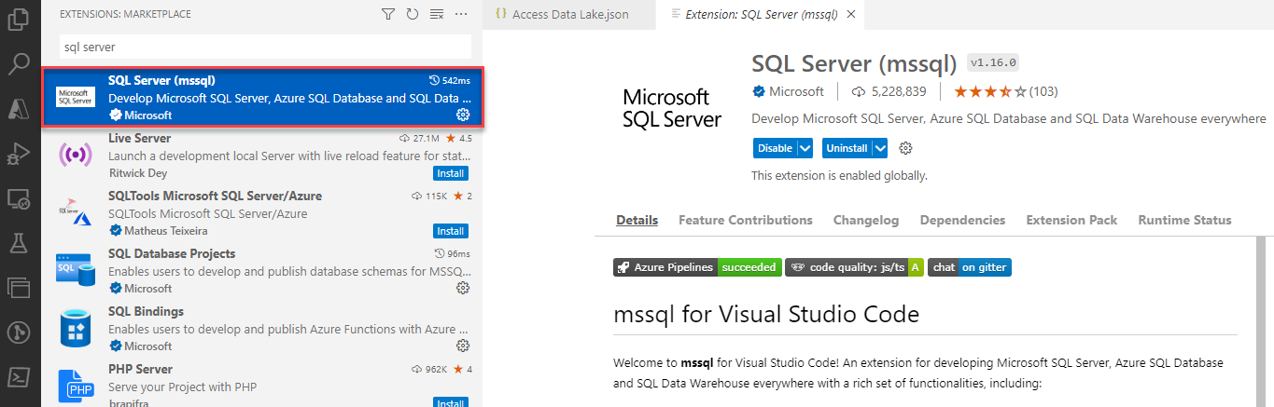
Data Access
Azure Data Studio / SQL Server Management Services
VS Code and SQL Server (mssql) extension

Slide 39
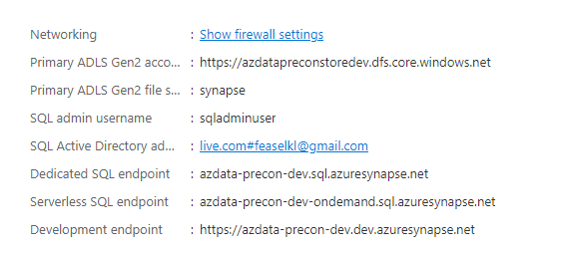
Data Access
Query a dedicated SQL pool
Dedicated SQL endpoint
Port 1433
Query the serverless SQL pool
Serverless SQL endpoint
Port 1433
Query Spark data
Save Spark tables to a Lake Database and query via serverless SQL pool

Slide 40
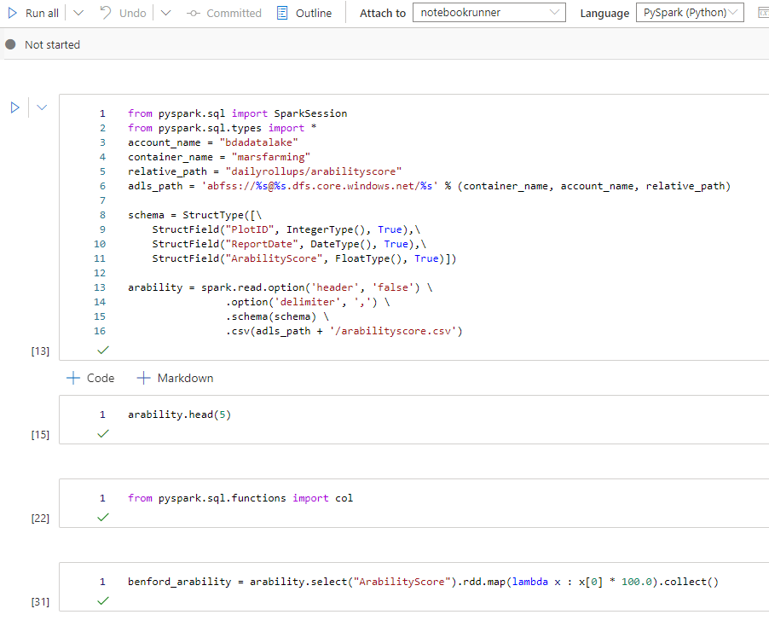
Developing a Python Notebook
Notebook UI similar to Jupyter
Choose a default language: Python, Scala, C#, SQL, R
Can switch languages between cells with %%[lang] magic
%%sparksql
%%pyspark
Must attach to a Spark cluster to run tasks

Slide 41
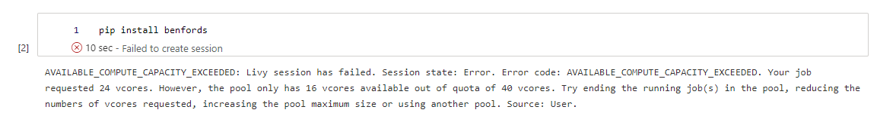
The Most Annoying Error

Slide 42
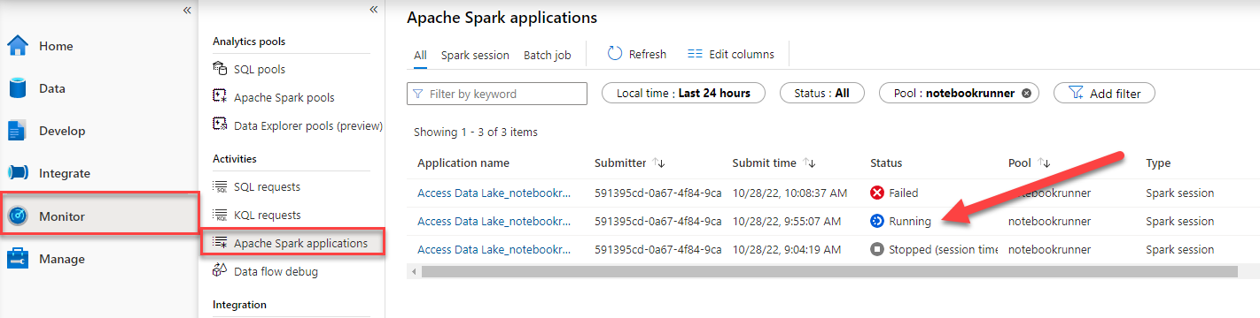
Find Running Jobs

Slide 43
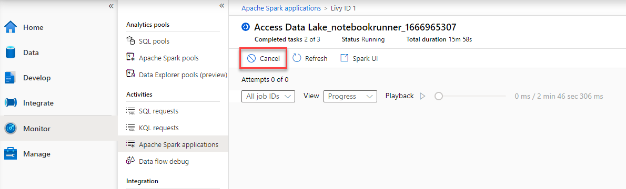
Nuke It from Orbit

Slide 44
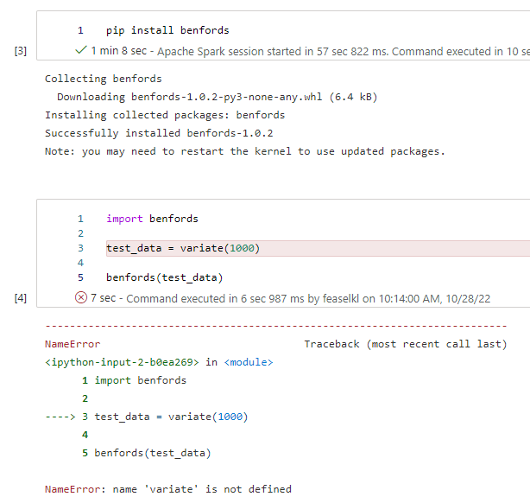
Installing Packages – Pip in Notebook
Generally NOT a good idea
Package won’t exist on cluster re-creation
Remember: Spark clusters are cattle, not pets!

Slide 45
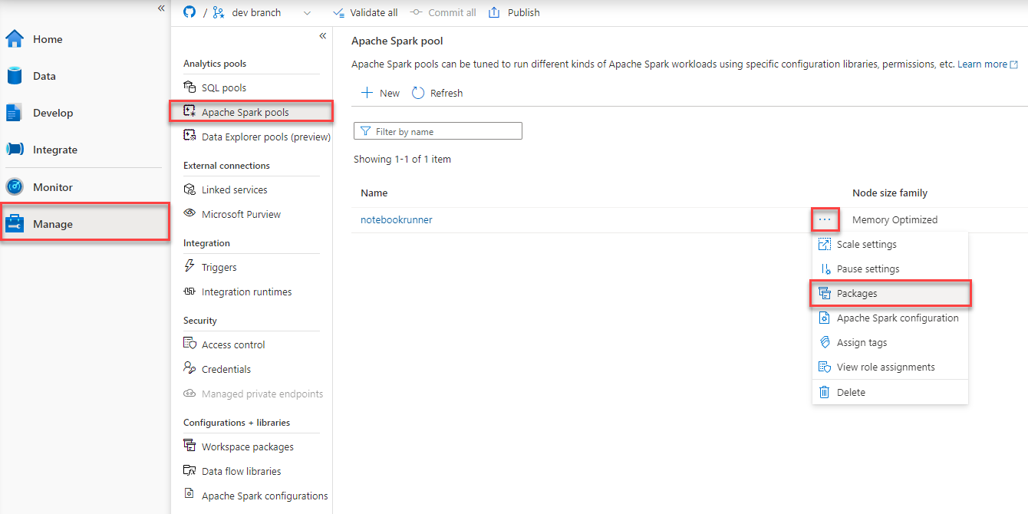
Python Package Management

Slide 46
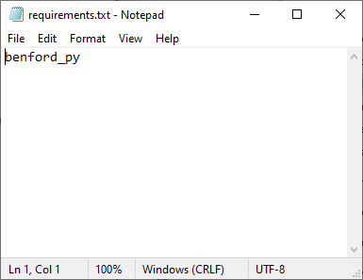
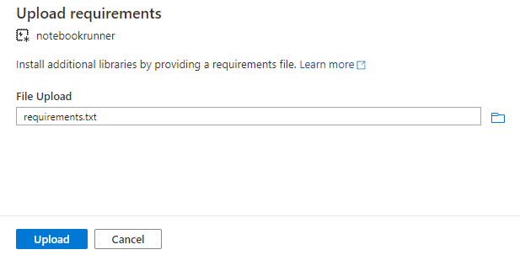
Installing Packages – Requirements.txt

Slide 47
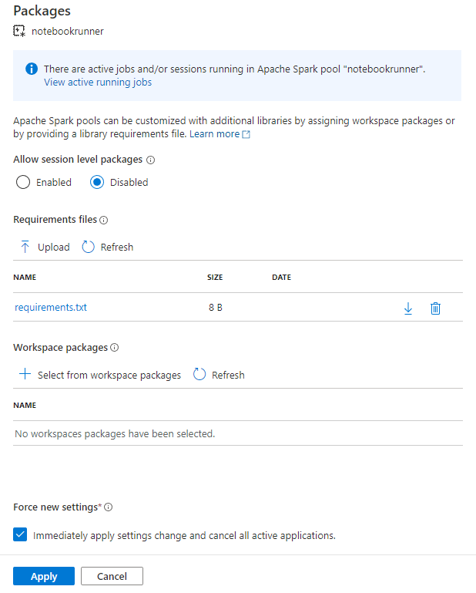
Installing Packages – Requirements.txt
Can define separate package requirements per Spark pool
Packages installed before each new instance of a Spark pool starts up
Can increase the startup time of Spark clusters
Libraries do get cached

Slide 48
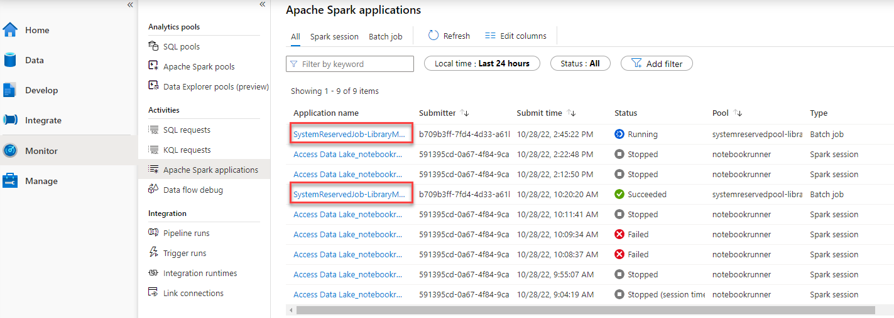
Installing Packages – Requirements.txt

Slide 49
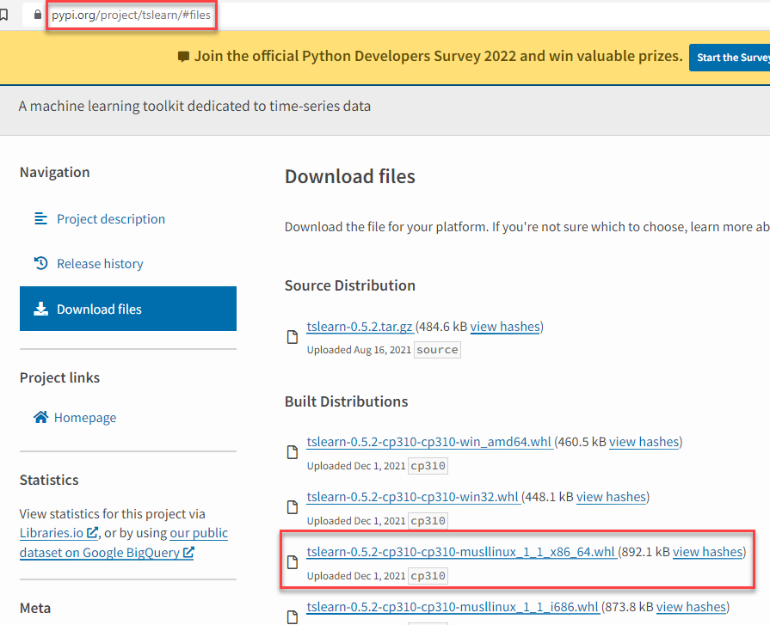
Installing Packages – Workspace Package
Step 1: obtain a Wheel (.whl) package
Step 2: Upload the workspace package to Synapse
Step 3: profit

Slide 50
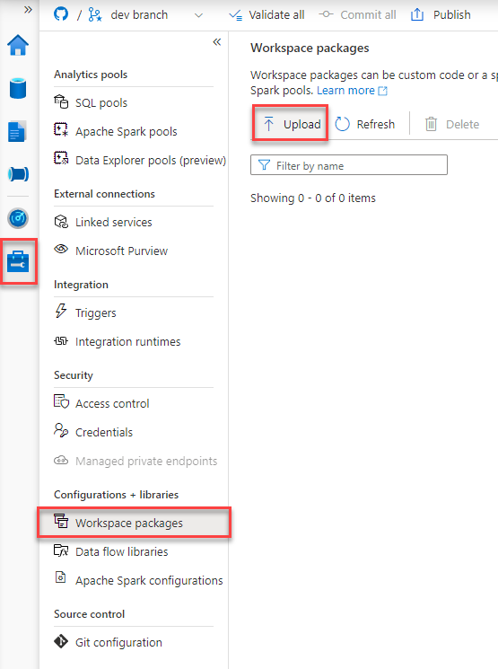
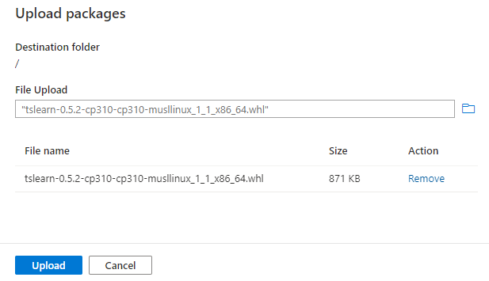
Installing Packages – Workspace Package

Slide 51
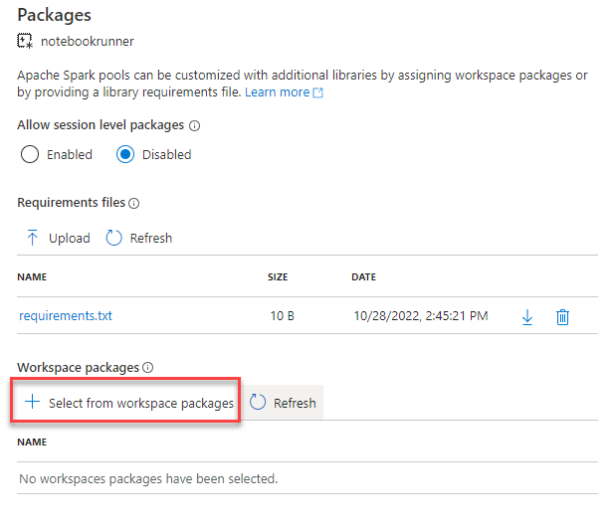
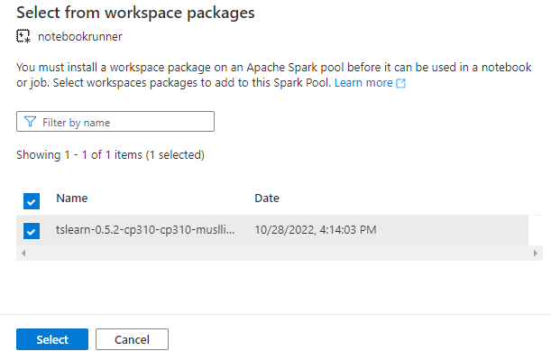
Installing Packages – Workspace Package

Slide 52
Installing Packages when DEP is Enabled
One consequence of Data Exfiltration Protection: no public IP address for Spark clusters
Can NOT access public internet resources for pip or conda
Should install packages or wheel files as Workspace packages

Slide 53
Lab Part 1
Create a Spark pool
Import notebooks from source control
Build out a notebook
Manage packages
Try out basics of Python

Slide 54
Data Lake

Slide 55
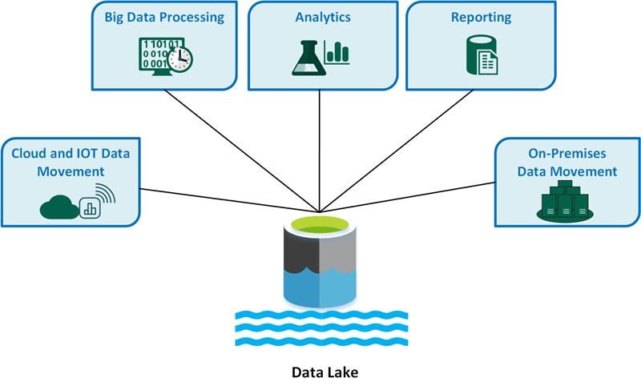
Data Lake Basics
Data stored in Azure Data Lake Storage Gen2
May use storage account associated with Synapse or bring in another storage account as a linked service
Data on-prem or in another cloud service (e.g., S3)? Need to import into a storage account

Slide 56
Data Lake Strategy
Create separate storage accounts per environment: dev, test, prod
Use a common folder structure based on level of refinement
“Databricks Name” | “Common Name” | Use Case
Bronze | Raw | Raw data imported from external data sources
Silver | Refined | Data after cleanup, transformations, extensions, and restructures. “Known good” data ready for queries
Gold | Curated | Data with additional measures and pre-computed aggregates. “Report-ready” data intended for importation into tools like Power BI

Slide 57




Raw Data
Information coming from source systems or events
Store this incoming information long-term
Source systems tend not to save history, so we want to do so
Able to rebuild later layers in event of bug in code
Data Sources
Raw Layer
Refined Layer
Curated Layer

Slide 58
Data Loading Techniques
Batch data loading
Alternative load options
Take data from sources and save as CSV or Parquet files
One option: use AzCopy to upload data to Data Lake Storage
Especially easy moving files from S3 or Google Cloud
Self-hosted integration runtime on-premises
Extract and copy data from Synapse Pipeline
Stream in data and handle via Stream Analytics or Spark Streaming

Slide 59
Data Transformation for the Data Lake
Input batch formats
Input stream sources
Delimited text
Avro
Parquet
ORC
JSON
XML
Event Hub
IoT Hub

Slide 60
Data Cleansing Operations
Typically handled through Spark pools – Python, Scala, maybe F#/C#
Common file issues:
Improperly formatted delimited files
Restructuring free-form text
Nested data
XML data inside file
Missing / NULL entries

Slide 61
Data Cleansing Operations
Don’t forget data issues!
Impossible values (e.g., age > 200, salary < 0)
Mismatched values (e.g., X in system 1, Y in system 2)
Inaccurate data (e.g., need legal name but sent nickname)
Duplicate data
Misspellings
Old data mixed with current (e.g., FLA and MIA Marlins)
Impute or calculate missing values
Reminder: fix data issues as early as possible, where you have the most information

Slide 62
Refining Data
“Refined” data: useful for querying and analysis in tools like, e.g., serverless SQL pool
Known good data—or at least as good as possible!
Ideally, one file contains sufficient information for a query—we aren’t normalizing data here!
Data Sources
Raw Layer
Refined Layer
Curated Layer

Slide 63
Curating Data
“Curated” data: ready for reporting tools
Additional measures created: new aggregates or calculations
Aggregates pre-calculated to make loading faster
Data shaped in a way which makes it easy for tools like Power BI to load
Data Sources
Raw Layer
Refined Layer
Curated Layer

Slide 64
Making Data Accessible
Security
Storage Blob Data Contributor
Can lock down Raw data to data engineers—end users don’t need to see this
Refined should be accessible to analysts
Curated should be accessible to end users and reporting tools
Consistency
Scheme consistency: as common a folder structure as is reasonable
Format consistency: Parquet for stored files
Few stops—ensure users don’t need to join multiple folders together to get basic work done

Slide 65
Secrets Management

Slide 66
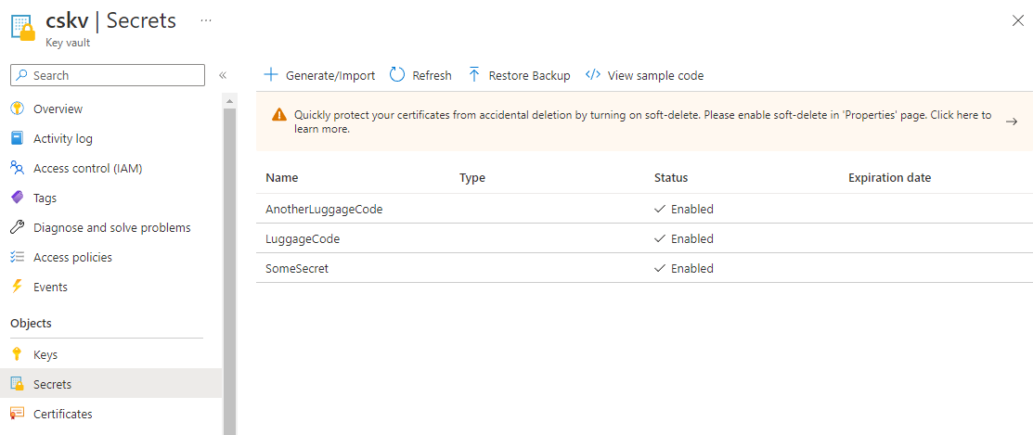
Key Vault
Azure service for secrets management
Securely store and manage keys, certs, other secrets

Slide 67
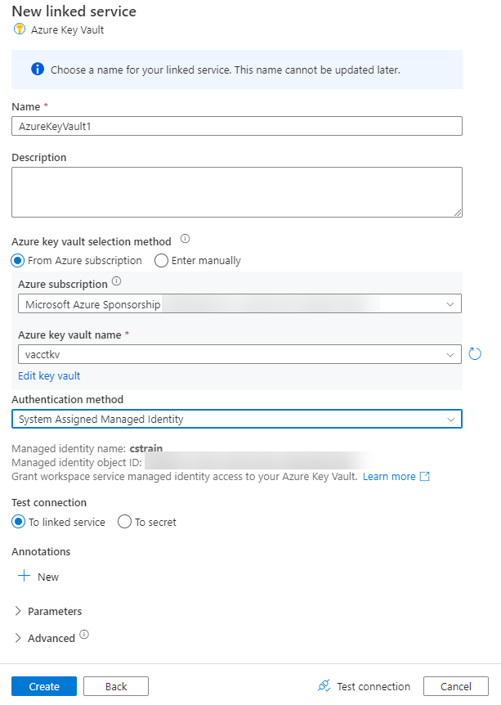
Connect to Key Vault
Create a linked service in Synapse
Connect using a managed identity—no service account passwords to update
Given certain circumstances, can ensure Key Vault traffic never leaves Azure networks

Slide 68
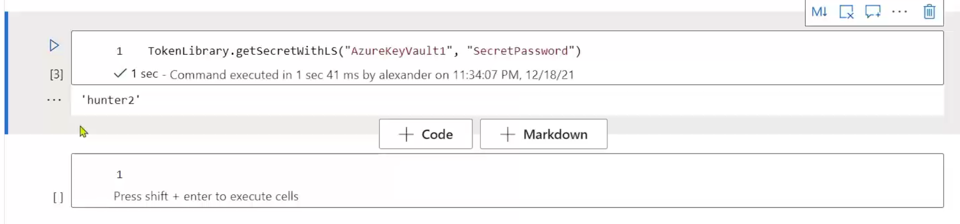
TokenLibrary
Library allowing you to query Key Vault from Spark pools
Prevent storing sensitive details in notebooks

Slide 69
Lab Part 2
Read data from the data lake
Process data with Python and Spark SQL
Write results to the data lake

Slide 70
Synapse Pipelines

Slide 71
Synapse Pipelines Overview
Based on the Azure Data Factory codebase
Intended for Extract-Load-Transform (ELT) jobs
By contrast, SQL Server Integration Services intended for ETL
UI-friendly mechanism to move data from source systems into data lake
Can execute tasks on data inside the data lake
Run Spark notebooks
Execute dedicated SQL pool stored procedures
Run SQL scripts

Slide 72
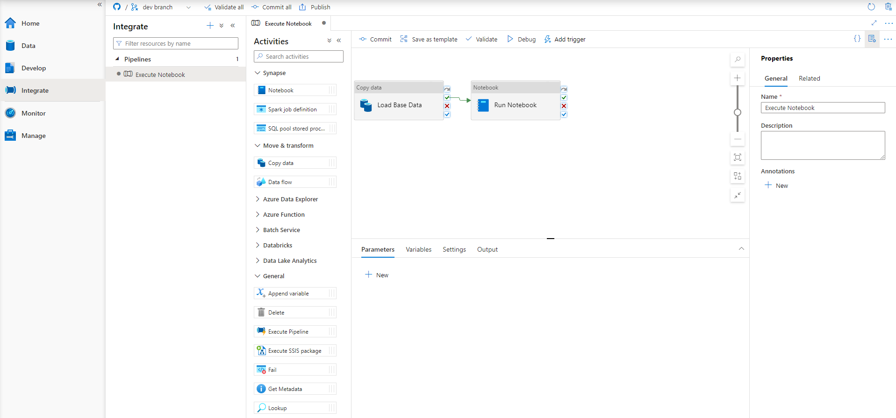
Synapse Pipeline Overview

Slide 73
Azure Data Factory vs Synapse Pipelines
Category | Feature | Azure Data Factory | Azure Synapse Analytics
Integration Runtime | Using SSIS and SSIS Integration Runtime | ✓ | ✓ Public preview
 | Support for Cross-region Integration Runtime (Data Flows) | ✓ | ✗
 | Integration Runtime Sharing | ✓ Can be shared across different data factories | ✗
Pipelines Activities | SSIS Package Activity | ✓ | ✓ Public preview
 | Support for Power Query Activity | ✓ | ✗
Template Gallery and Knowledge center | Solution Templates | ✓ Azure Data Factory Template Gallery | ✓ Synapse Workspace Knowledge center
GIT Repository Integration | GIT Integration | ✓ | ✓
Monitoring | Monitoring of Spark Jobs for Data Flow | ✗ | ✓ Leverage the Synapse Spark pools

Slide 74


Orchestration Components
Trigger
Pipeline
foreach (…)
On demand
Schedule
Data Window
Event
Activity
Activity
Activity
Activity
Activity
Self-hosted
Integration Runtime
Azure
Integration Runtime
Linked
Service
LEGEND
Azure Services
Command and Control
On-prem
Apps & Data
Data
Synapse Pipelines shares codebase with Azure Data Factory

Slide 75
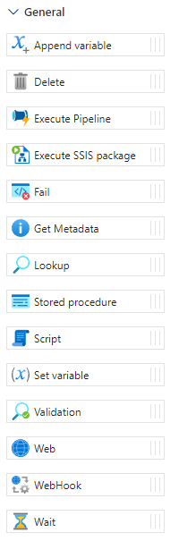
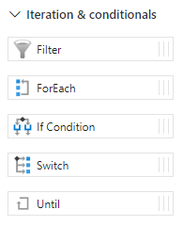
Creating a Synapse Pipeline
Hand-write JSON or drag components from the Synapse Studio UI
If coming at this from SSIS, think of this as Component view, not Data Flow view
Some structured programming operations available

Slide 76
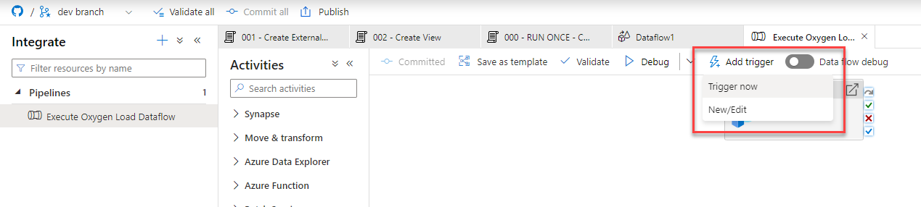
Running a Pipeline
Triggers execute pipelines
May run manually via Trigger now or on some operation
Schedule
Tumbling window
Event – storage or custom

Slide 77
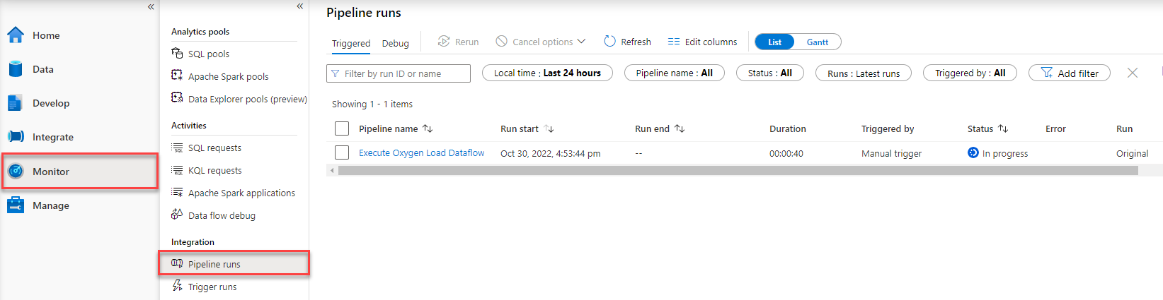
Monitoring a Pipeline
Review trigger results in the Monitor tab → Pipeline runs
Drill down into pipeline details to learn more about a given run, including why it failed

Slide 78
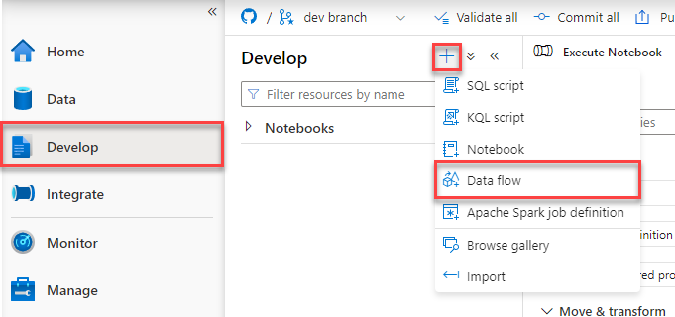
Mapping Data Flows
Classic Synapse pipeline: ELT
Copy data from some system
Execute some external task/script/job on the data
Mapping data flows allow for data transformation: ETL
Execute Data Flow by incorporating it in a Synapse Pipeline

Slide 79
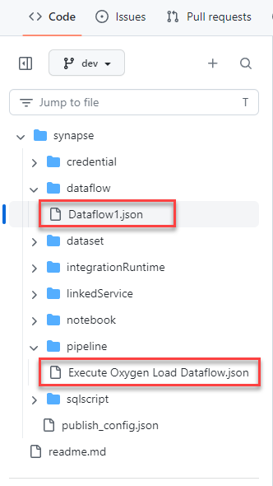
Pipeline Development and Source Control
Pipelines saved in JSON format in /pipeline/
Dataflows saved in JSON format in /dataflow/
Possible to hand-write and hand-edit JSON—don’t need UI

Slide 80
Lab Part 3
Convert notebook into Synapse pipeline
Execute notebook
Trigger on new data

Slide 81
Post-Lab Wrapup

Slide 82
What We Learned
Creating a Spark pool
Importing notebooks into a Synapse workspace
Running a Spark notebook
Building a simple ML model with PySpark
Writing prediction results to the data lake
Building a Synapse pipeline to execute a notebook

